Slide 1

6502 Debugger
Haley Whitman
Frazer Bayley
Alison Legge
Jeremy Brennan
Abdualziz AL-Heidous
CIS 422 – Dr. Faulk

Slide 2
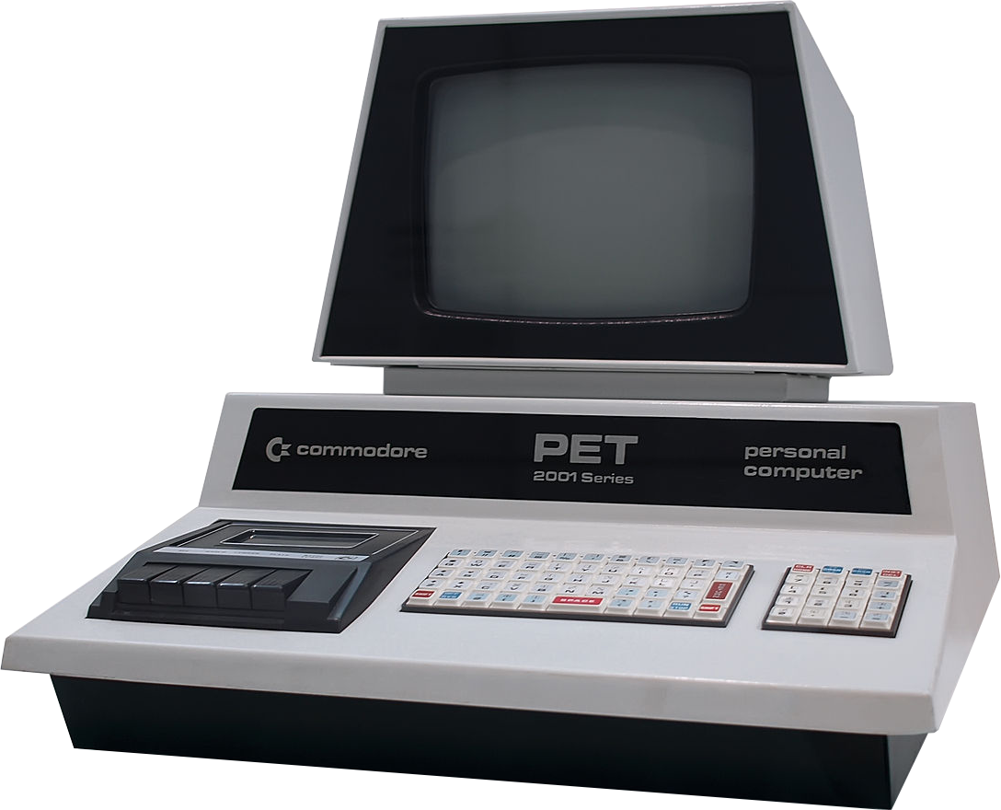
Background
Project is split into two deliverable parts
MOS Technology 6502 Processor
Debugging Interface for 6502 Assembly
Requirements for 6502 Processor
Accurately emulate the behavior of a 6502 processor.
Allow for third-party control of the processor.
Requirements for the debugging interface
1. Allow for a user to input 6502 assembly
2. Allow for the user to view the results, and step through their inputted program.

Slide 3
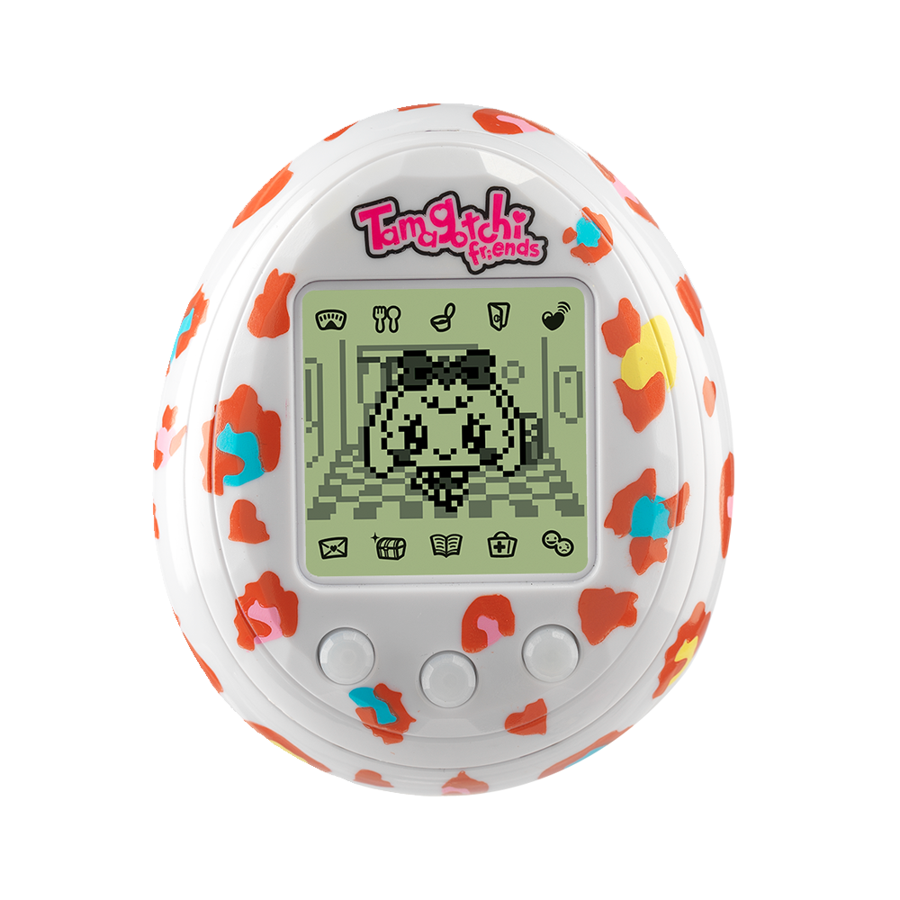
Project Plan
Followed an iterative design, split between
Creating the processor.
Creating the debugging interface.
We created the module design for the processor from Synertek and MOS Technology’s 6502 Programming/Hardware manual.
We followed customer requests and typical debugging use-cases to design the debugging interface. Our documentation focused much more heavily on the debugging interface.
We have met all the customer requirements laid out for us, and documentation needed for the class. Deliverables are laid out in the following slides.

Slide 4
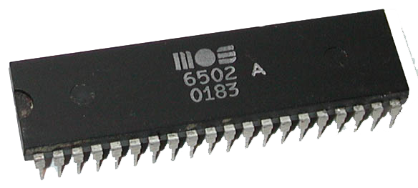
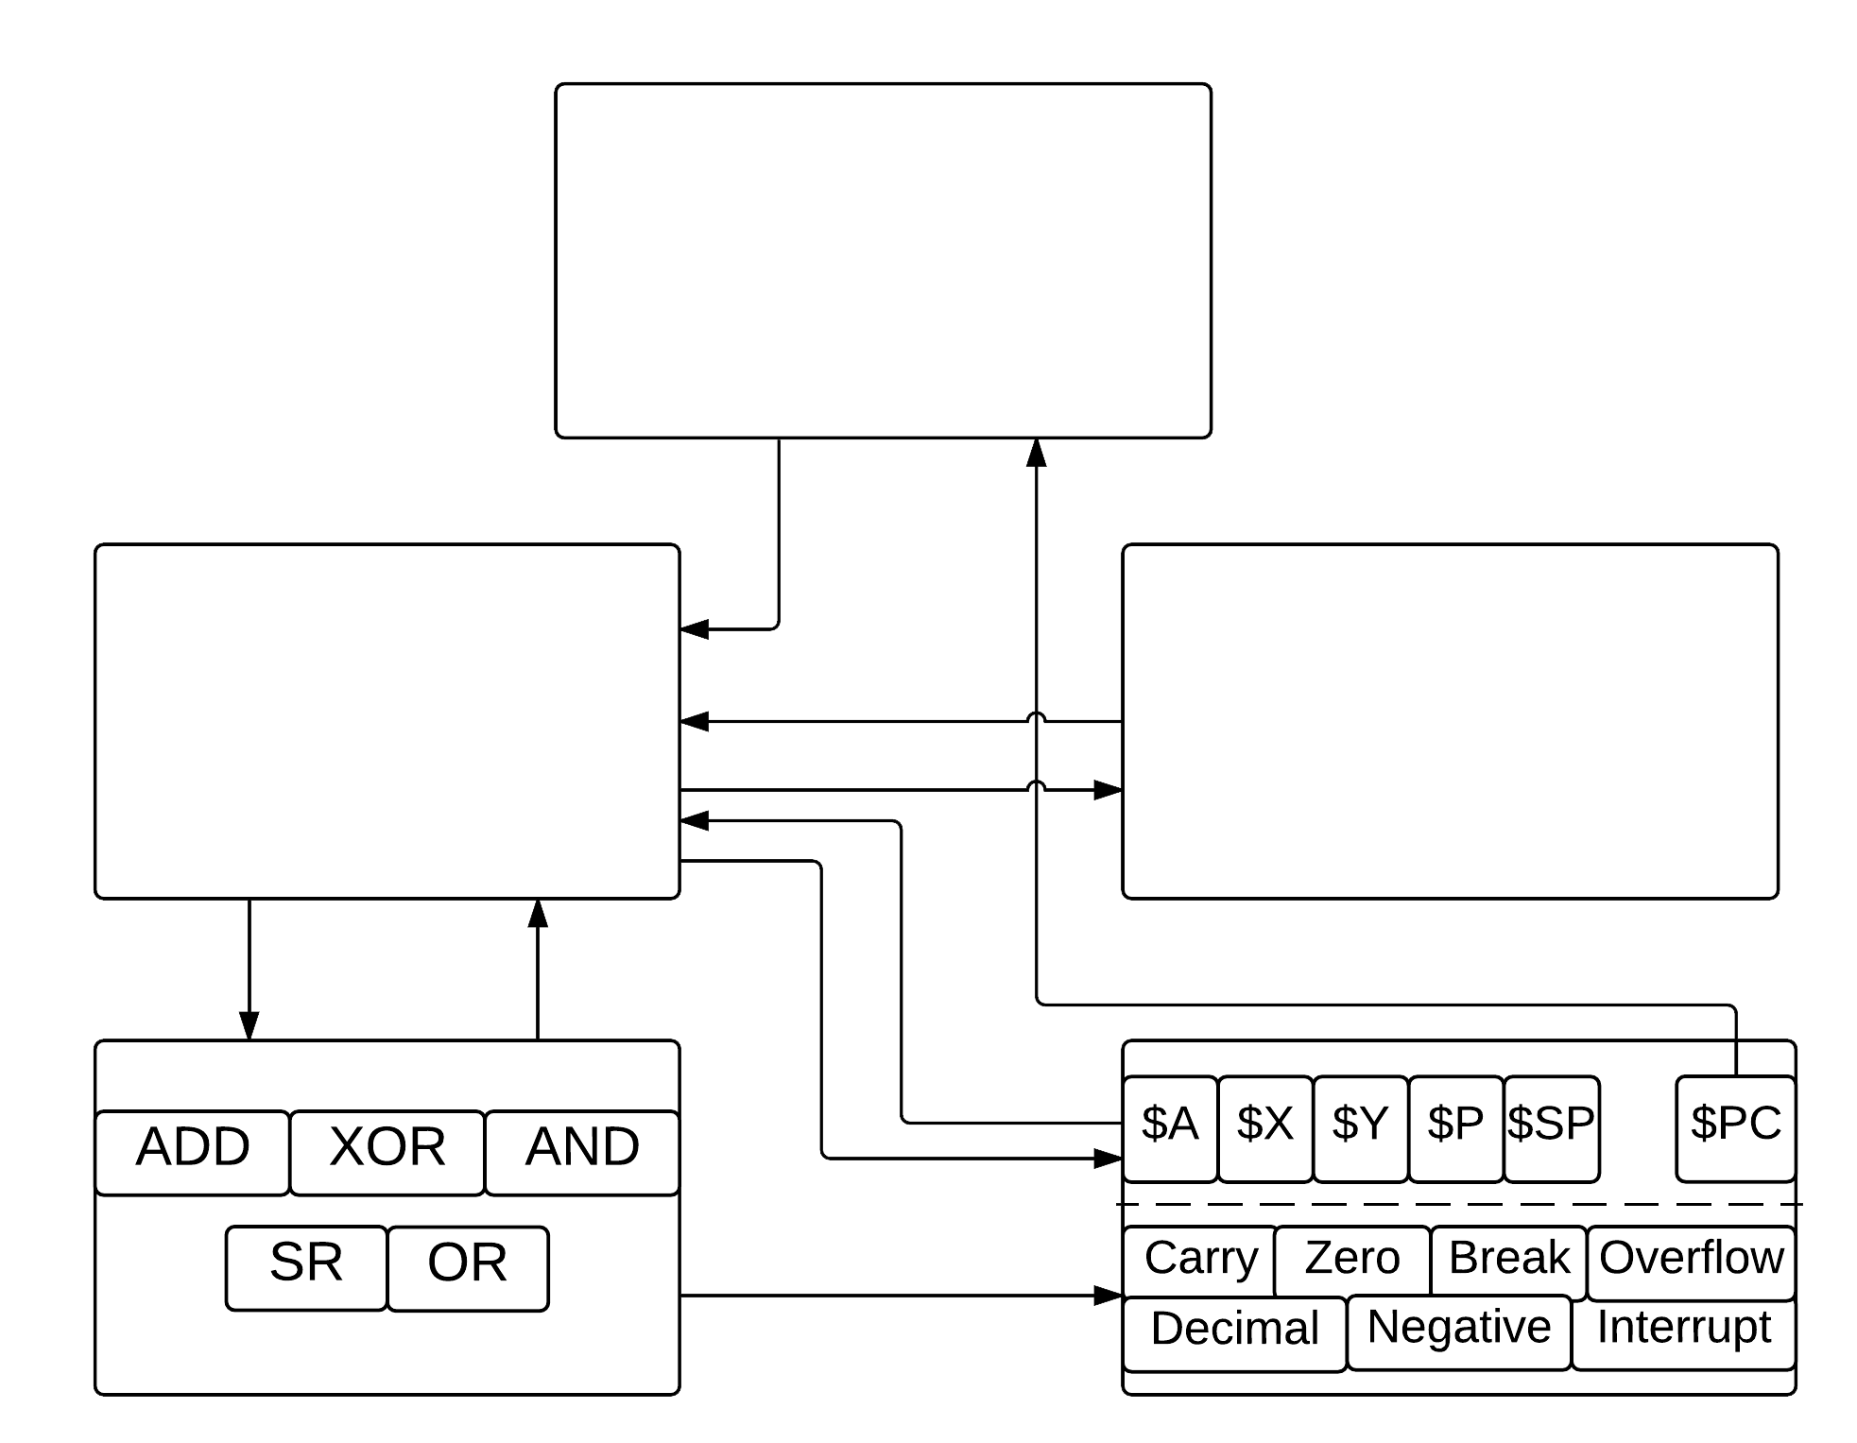
Central Processing Unit (CPU)
Processor Design
Allows control of processor by third-party applications. Decodes current instruction.
Fairly typical design specification
Follows original dataflow of 6502 processor
Instructions
Memory
1-to-1 mapping of 156 standard 6502 instructions.
Contains read/writes of standard 6502 memory. (16Kb of memory)
Arithmetic Logical Unit (ALU)
Registers

Slide 5
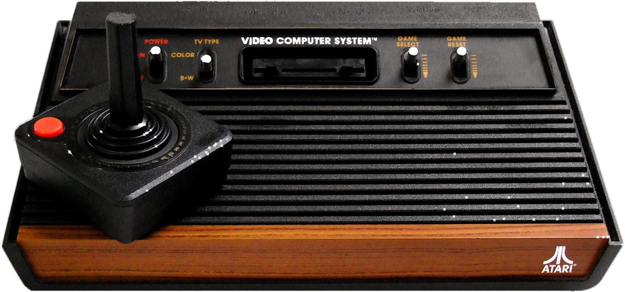
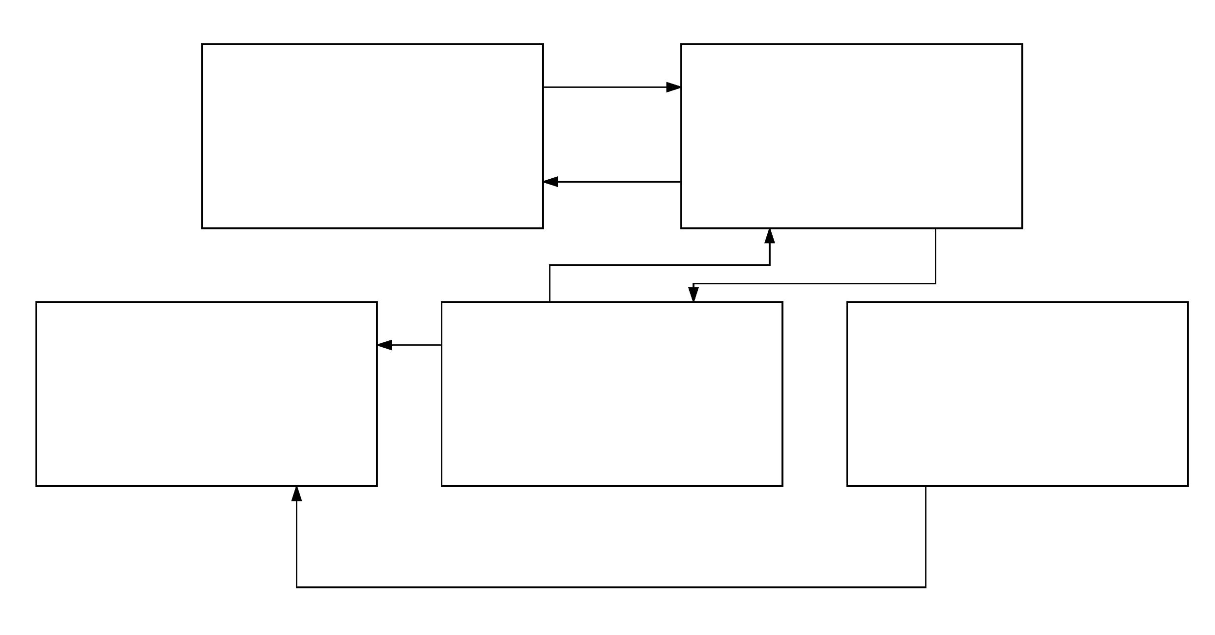
DEBUGGER Design
GUI for Debugger
Debugger Backend
All frames and viewing panels
Supports viewing, and accesses the processor interface
Fairly typical debugging interface,
modeled after more retro-based debuggers for processors such as the Gameboy, where analyzing memory output is helpful.
Has to easily allow for further features.
Written completely separate from the processor
Assembler
Databank
Converts assembly into binary code
Parses user input and handles user errors
Contains mapping of assembly to binary opcode
Import

Slide 6
Customer
Requests
Three Main Points
Wanted to be able to load any set of standard 6502 programs.
Be able to fully execute, or step through the program in a variety of ways.
Be able to easily view the processor changing line by line
Customer Iterations
1. We continually presented the customer with the product, and received feedback on what to alter.
2. Multiple behavioral changes, involving controlling the flow of the processor.
3. Few interface changes.

Slide 7
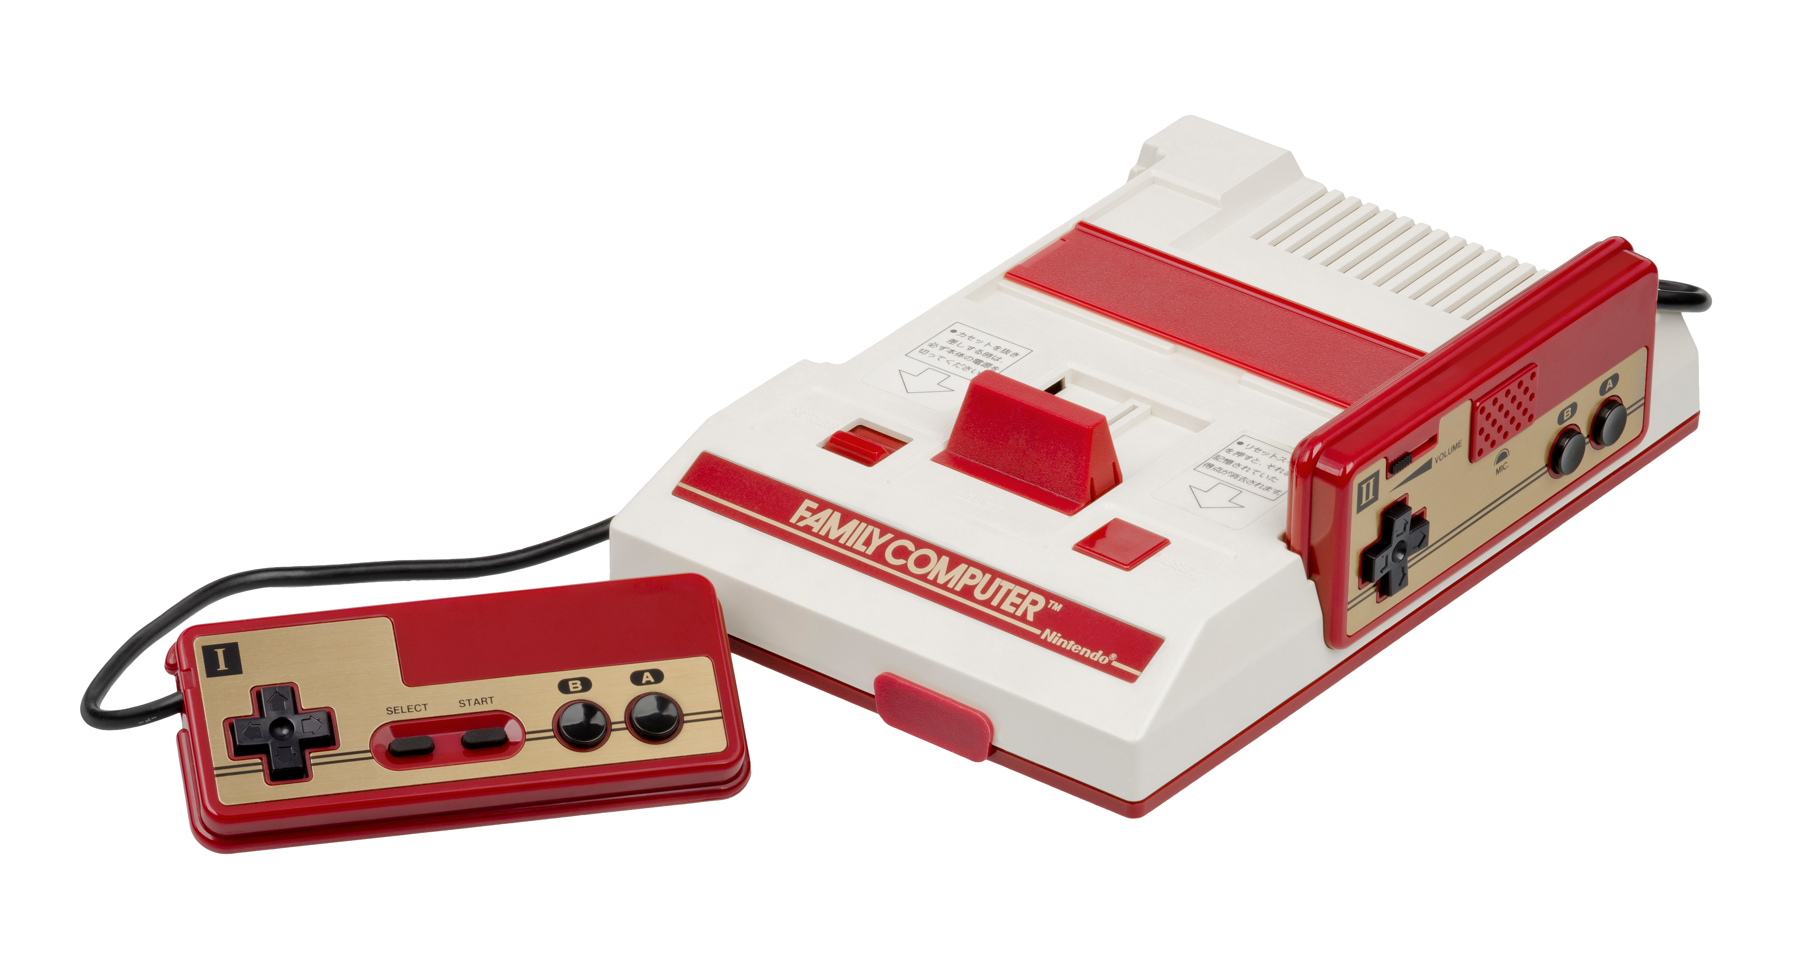
QA PLAN
Code Reviews
All processor, and specific debugger module code have unit tests written for them. This allowed for regression testing.
Overall code behavior was done by running a suite of 6502 assembly programs. Processor behavior was compared with other 6502 emulators.
Documentation Reviews
Feedback was received for all documentation, and reviews were completed by two people per document, each focusing on specific aspects of the document.

Slide 8
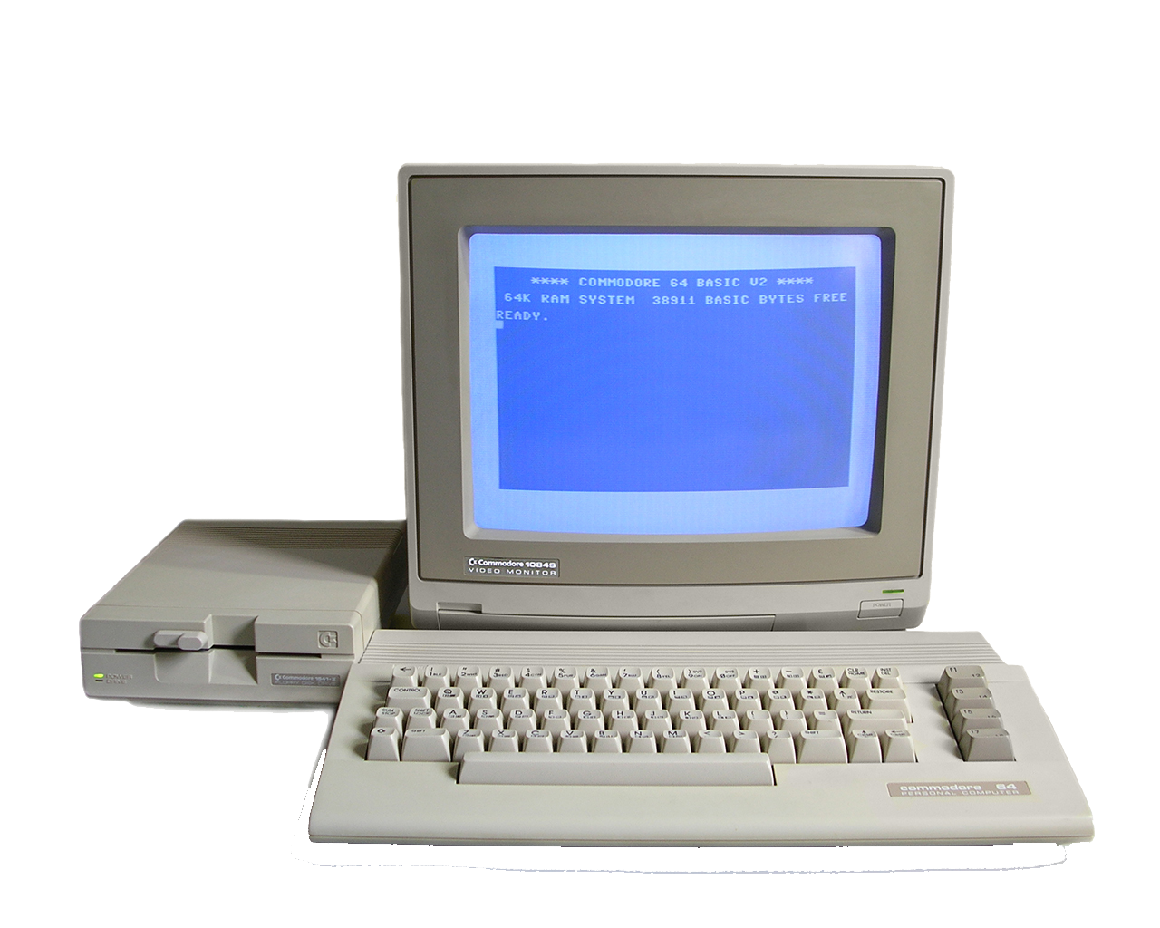
Lesson's Learned
Documentation
Documentation drafts were mostly on schedule. There were some issues with getting reviews implemented into the main documentation. This was addressed by doing more complete reviews after the initial review.
Needed a better way of organizing requests made for the documentation in the classroom.
Coding
We had a great module structure, allowed for a lot of concurrent work, and was very effective for our team.
We employed heavy use of pair-programming, which greatly helped in understanding the flow of the processor.

Slide 9
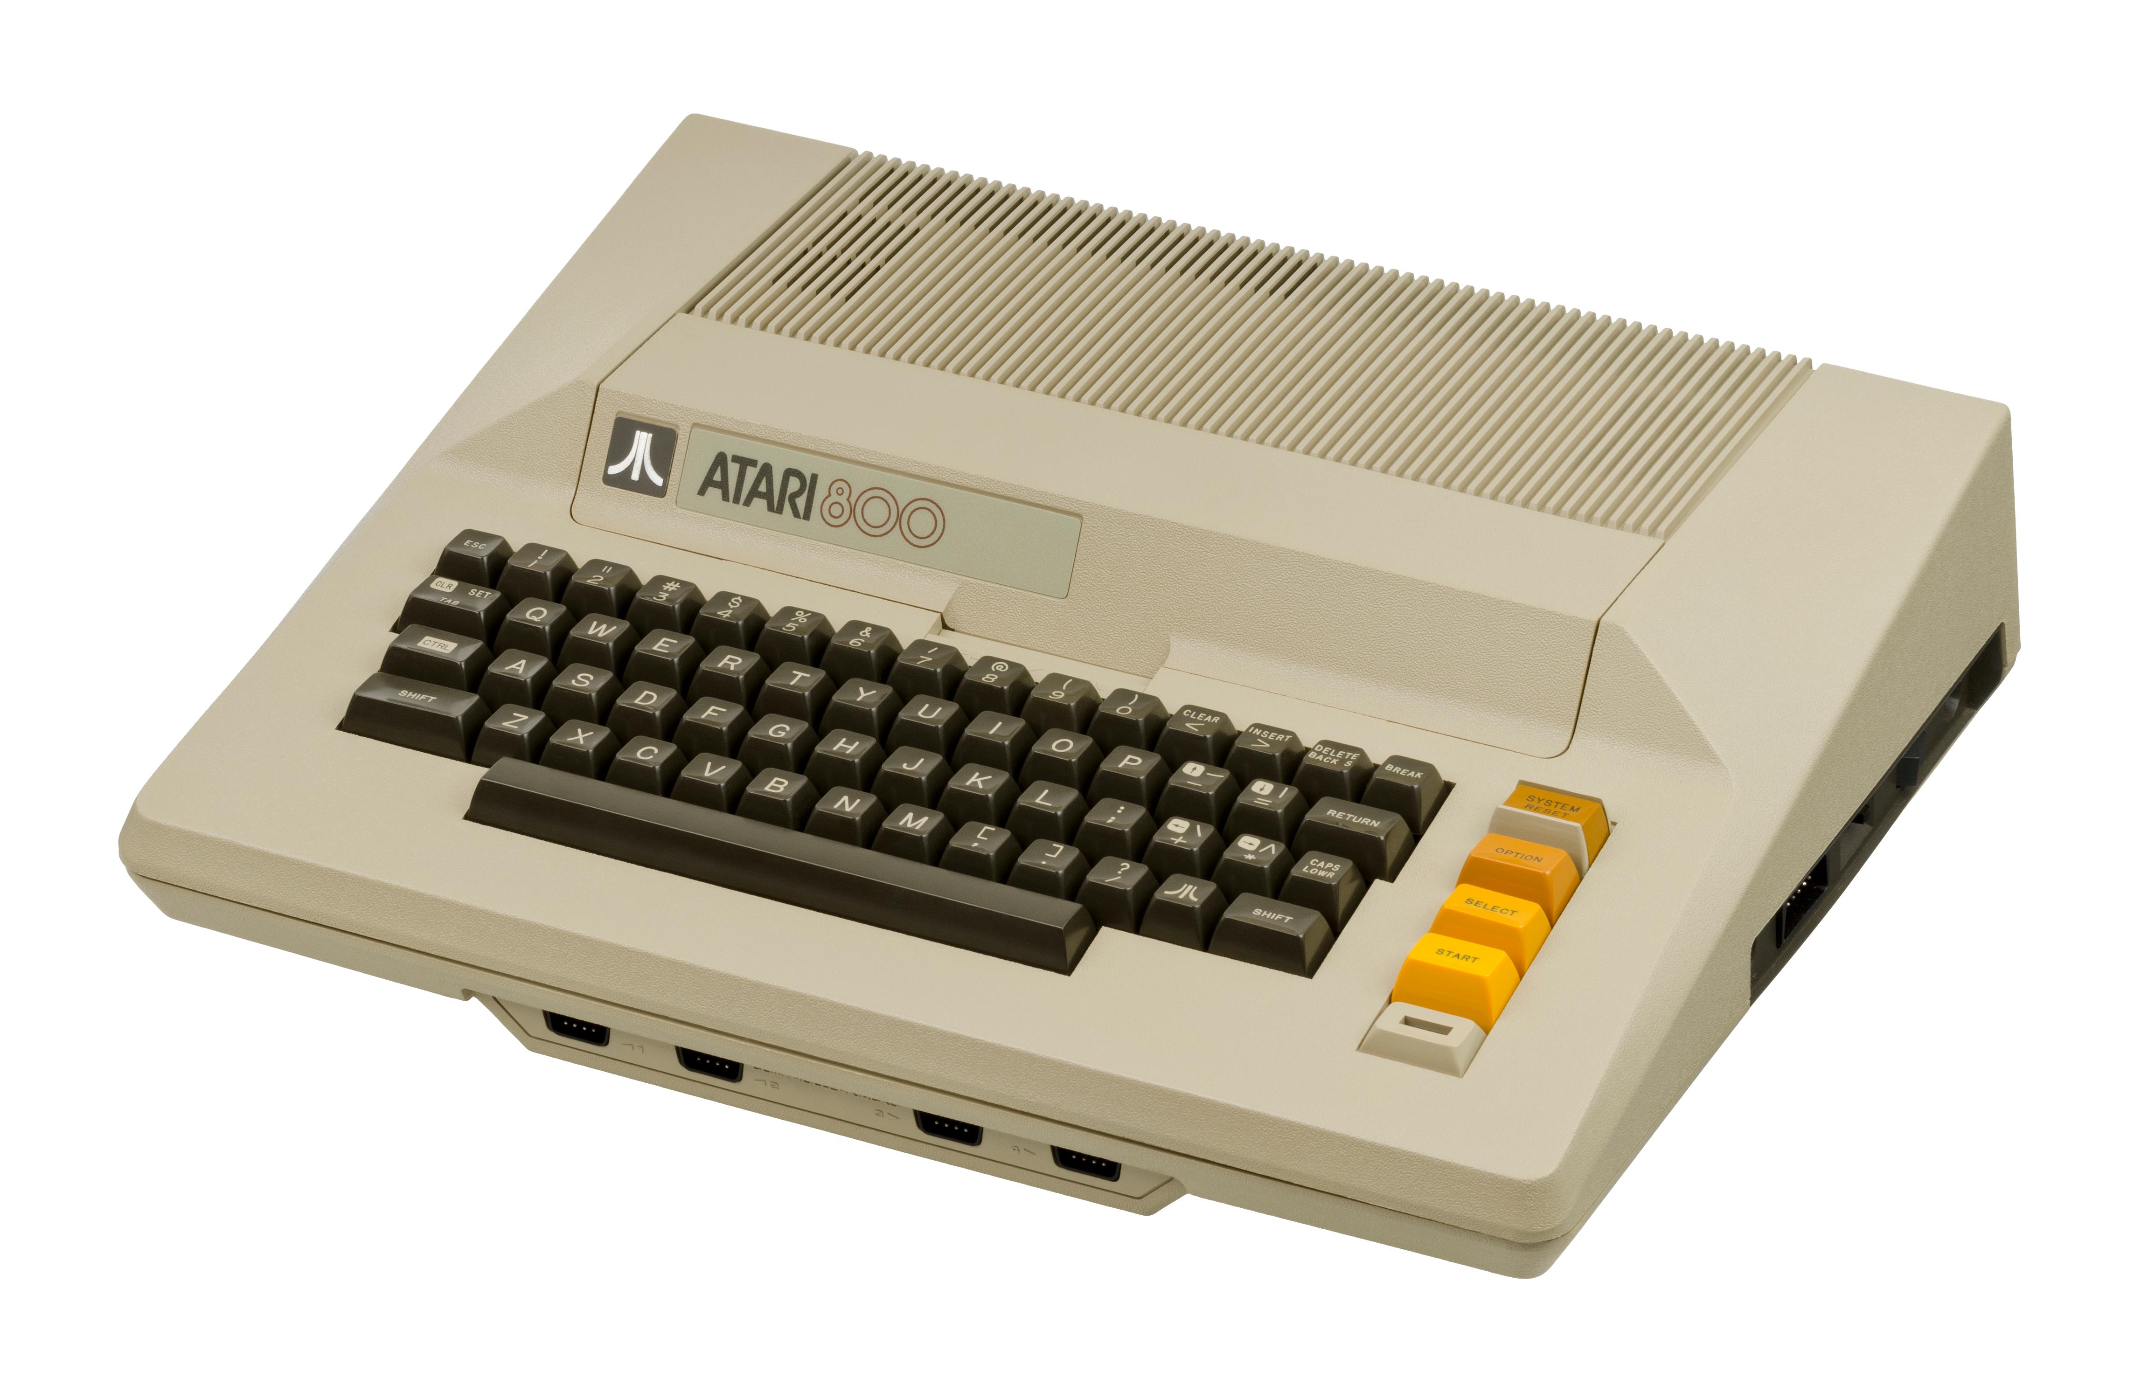
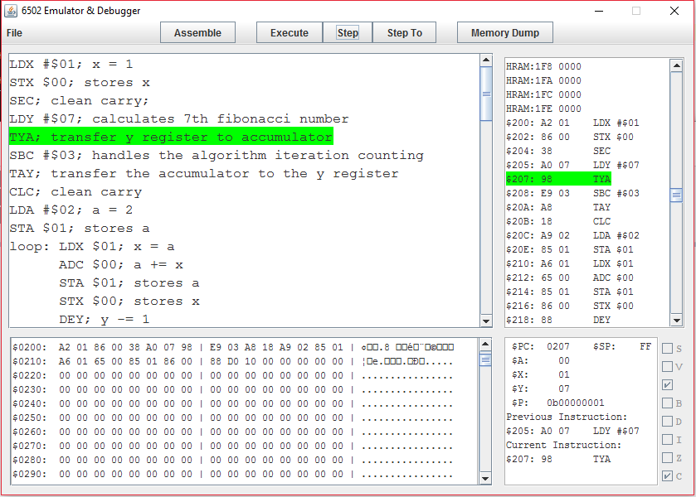
Application

Slide 10
Application
Memory gets stored, and updated with every CPU cycle. This is easily viewed in base-16, split every 16 bytes.
The ASCII memory representation is shown on the left.

Slide 11
Application
All register values are updated at every cycle (Shown in base-16).
The previous and currently executed instruction are also shown
Register flags are visualized with checkboxes, if they are currently set.

Slide 12
Application
A more detailed look at the processor’s Zero page, High-Index Ram, and starting ROM.
Opcodes and values are displayed for instructions, and their assembly translation is also shown and highlighted at each step.

Slide 13
Application
The user can type, import, or copy and paste standard 6502 assembly into this window.
Once assembled, the currently executed line will be highlighted as the program gets ran.

Slide 14
Application
All programs must be assembled, before any execution commands can be given.
Execute will fully run the program.
Step will run one cycle of the processor.
Step to will allow for a label to be chosen, and the processor will execute to there.

Slide 15
Course improvements

